Slide 1
Lenders Club Case Study
November 7, 2021
Shashank & Promit

Slide 2
Overview
The Lenders Club is the largest online loan marketplace, facilitating personal loans, business loans, and financing of medical procedures. Borrowers can easily access lower interest rate loans through a fast online interface.
When the company receives a loan application, the company has to make a decision for loan approval based on the applicant’s profile.

Slide 3
Understanding the problem
Two types of risks are associated with when the company receives a loan application
Problem 1
Problem 2
If the applicant is likely to repay the loan, then not approving the loan results in a loss of business to the company
If the applicant is not likely to repay the loan, i.e. he/she is likely to default, then approving the loan may lead to a financial loss for the company

Slide 4
Project objective:
Perform EDA to understand how consumer attributes and loan attributes influence the tendency of default.
Understand the driving factors (or driver variables) behind loan default, i.e. the variables which are strong indicators of default. The company can utilise this knowledge for its portfolio and risk assessment.

Slide 5
Findings & Recommendations: Univariate Analysis

Slide 6
Assumption Made
Risk Assessment -
>=25 is extremely risky
>= 15% and <25 is high risk
10% >= and <15% is medium risk
<10% is low risk
22

Slide 7
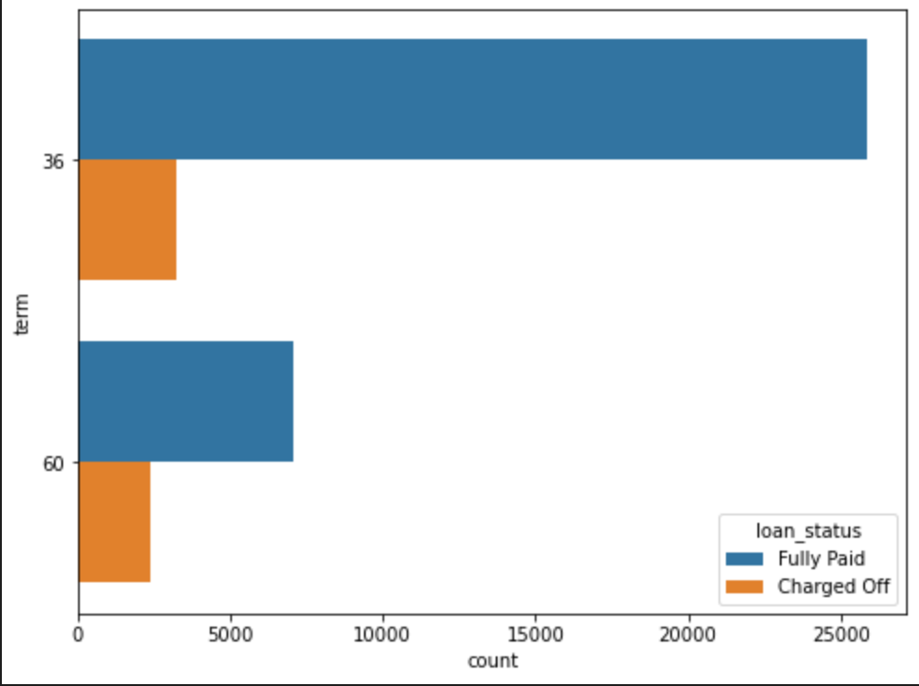
Finding 1: Loan Term
25% loans given for 5 years duration default as compared to 11% for 3 years.
Short Term Loans seems like safer bet to give loans to.
Term | Charged off %
36 | 11%
60 | 25.30%
22
Extremely Risky
High Risk
Medium Risk
Low Risk

Slide 8
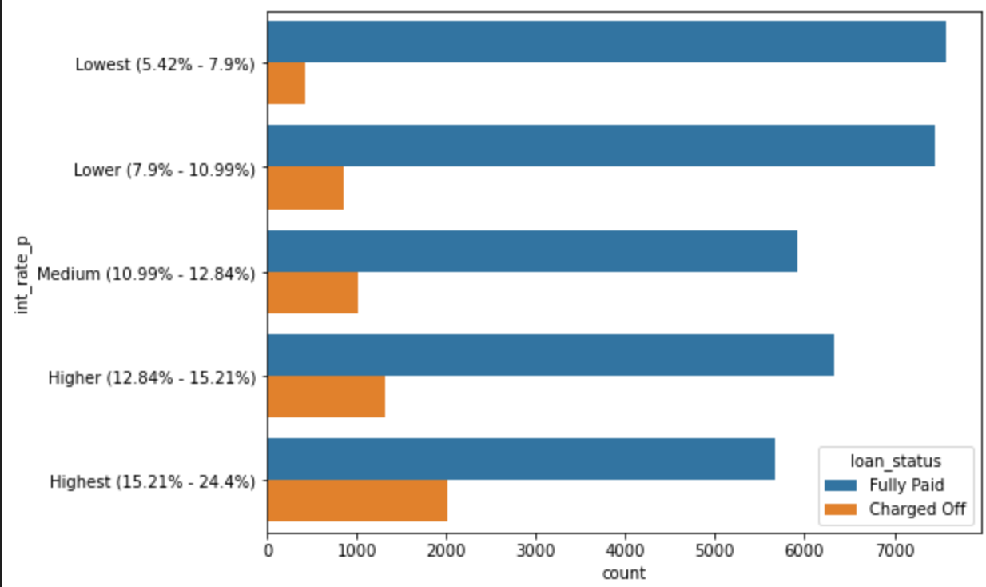
Finding 2: Interest Rates
Loans with interest rates less than 12.84% seems like a safer bet ( <15% risk) to give loans to.
As the interest rates go up, chances of default goes up.
More than quarter of the loans (26.22%) of loans with interest rates > than 15.21% default.
Interest rates | Charged off %
Lowest (5.42% - 7.9%) | 5.35%
Lower (7.9% - 10.99%) | 10.29%
Medium (10.99% - 12.84%) | 14.70%
Higher (12.84% - 15.21%) | 17.16%
Highest (15.21% - 24.4%) | 26.22%
22
Extremely Risky
High Risk
Medium Risk
Low Risk

Slide 9
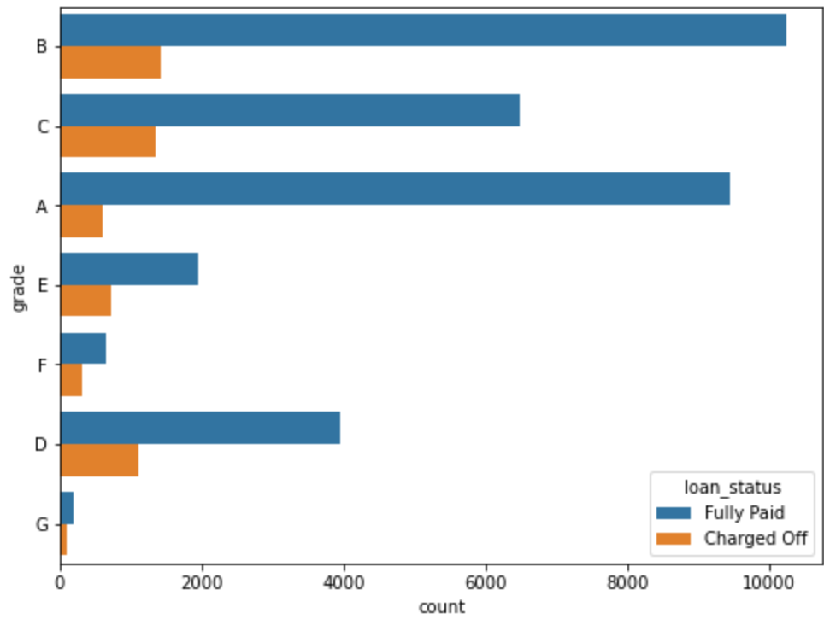
Finding 3: Grade
Grade E,F & G are extremely risky. Best to avoid.
C & D are high risk, can be evaluated.
A and B seem much safer in comparison to give loan for.
Higher the Grade, higher the chances of charged off
Grade | Charged off %
A | 5.99%
B | 12.21%
C | 17.19%
D | 21.99%
E | 26.85%
F | 32.68%
G | 33.78%
22
Extremely Risky
High Risk
Medium Risk
Low Risk

Slide 10
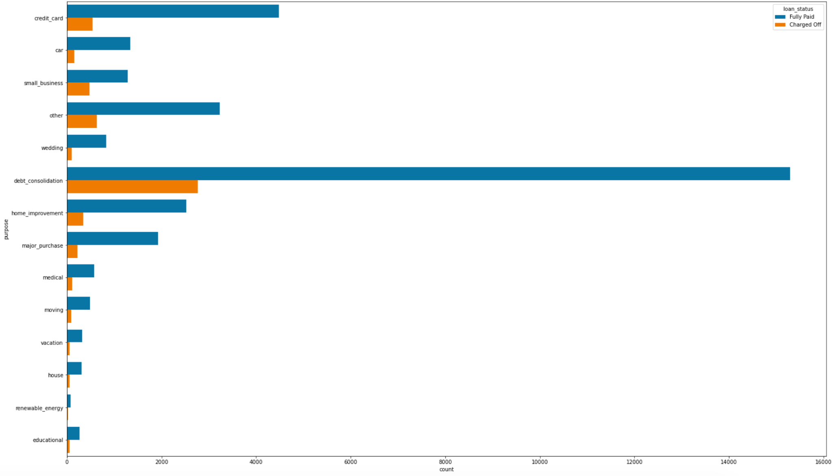
Finding 4: Purpose
Loans for small businesses are extremely risky, should be avoided.
Loans for Renewable Energy, Education and house loans are high risk, should be avoided.
Purpose | Charged off %
Major purchase | 10.33%
Wedding | 10.37%
Car | 10.67%
Credit card | 10.78%
Home improvement | 12.07%
Vacation | 14.13%
Debt consolidation | 15.33%
medical | 15.57%
moving | 15.97%
house | 16.08%
other | 16.38%
Educational | 17.23%
Renewable Energy | 18.63%
small_business | 27.08%
22
Extremely Risky
High Risk
Medium Risk
Low Risk

Slide 11
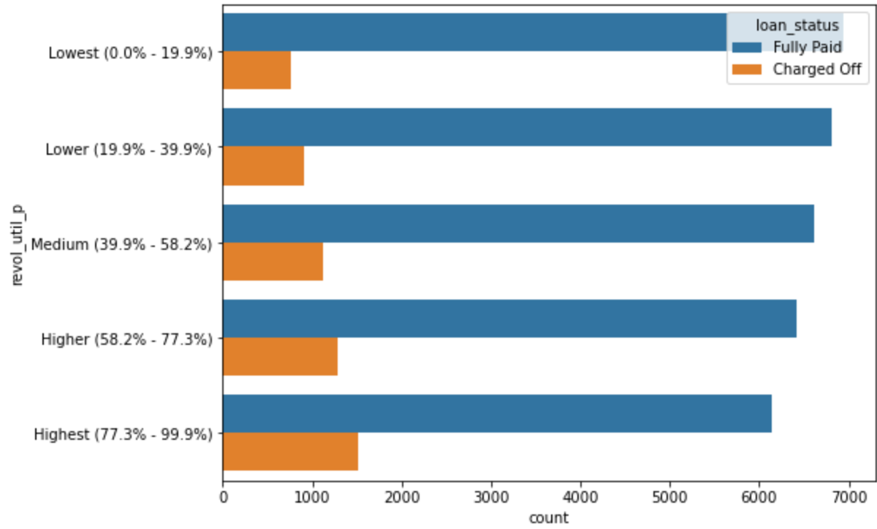
Finding 5: Revolving Line Utilization
Higher the Revolving Line utilization, higher the chances of charged off
Borrowers with Revolving Line Utilization greater than 58% should be avoided.
Revolving Line Utilization | Charged off %
Lowest (0.0% - 19.9%) | 9.94%
Lower (19.9% - 39.9%) | 11.84%
Medium (39.9% - 58.2%) | 14.50%
Higher (58.2% - 77.3%) | 16.77%
Highest (77.3% - 99.9%) | 19.81%
22
High Risk
Medium Risk
Low Risk

Slide 12
Findings & Recommendations: Bivariate Analysis

Slide 13
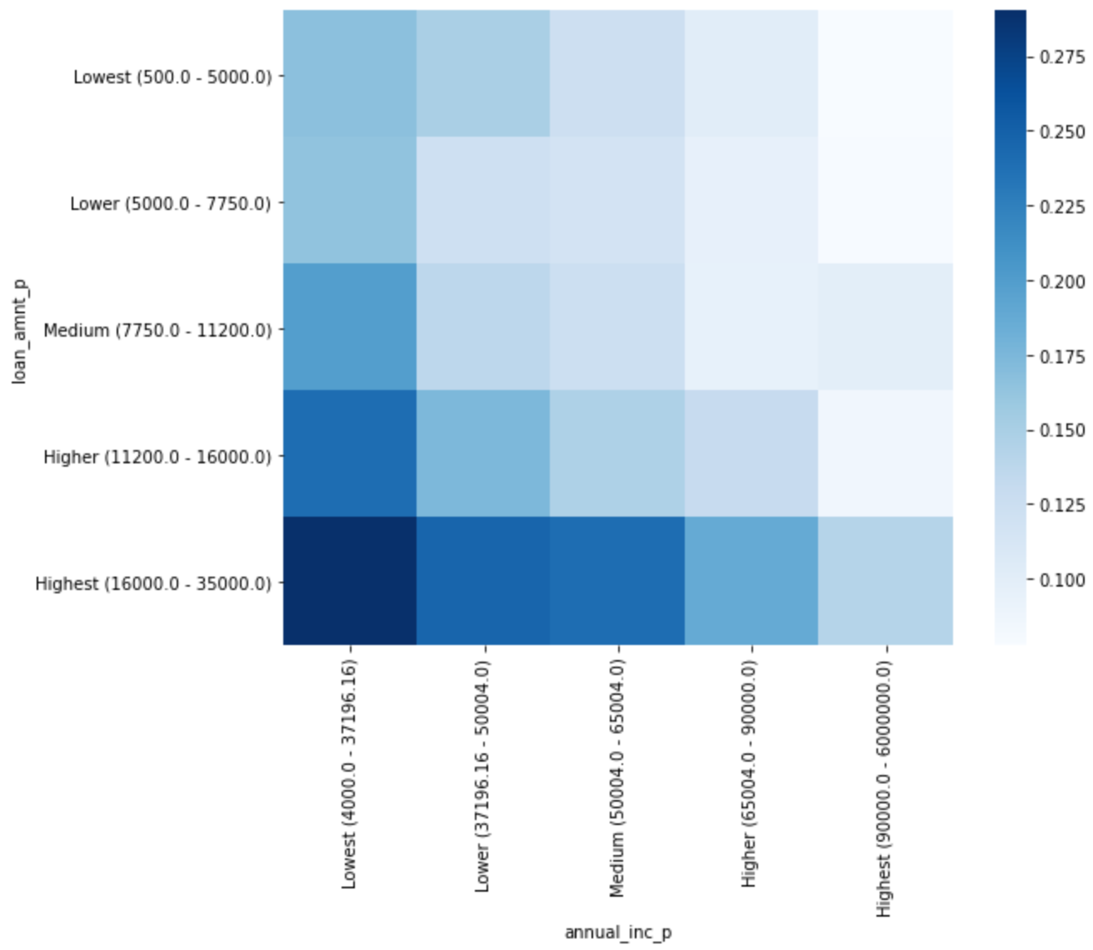
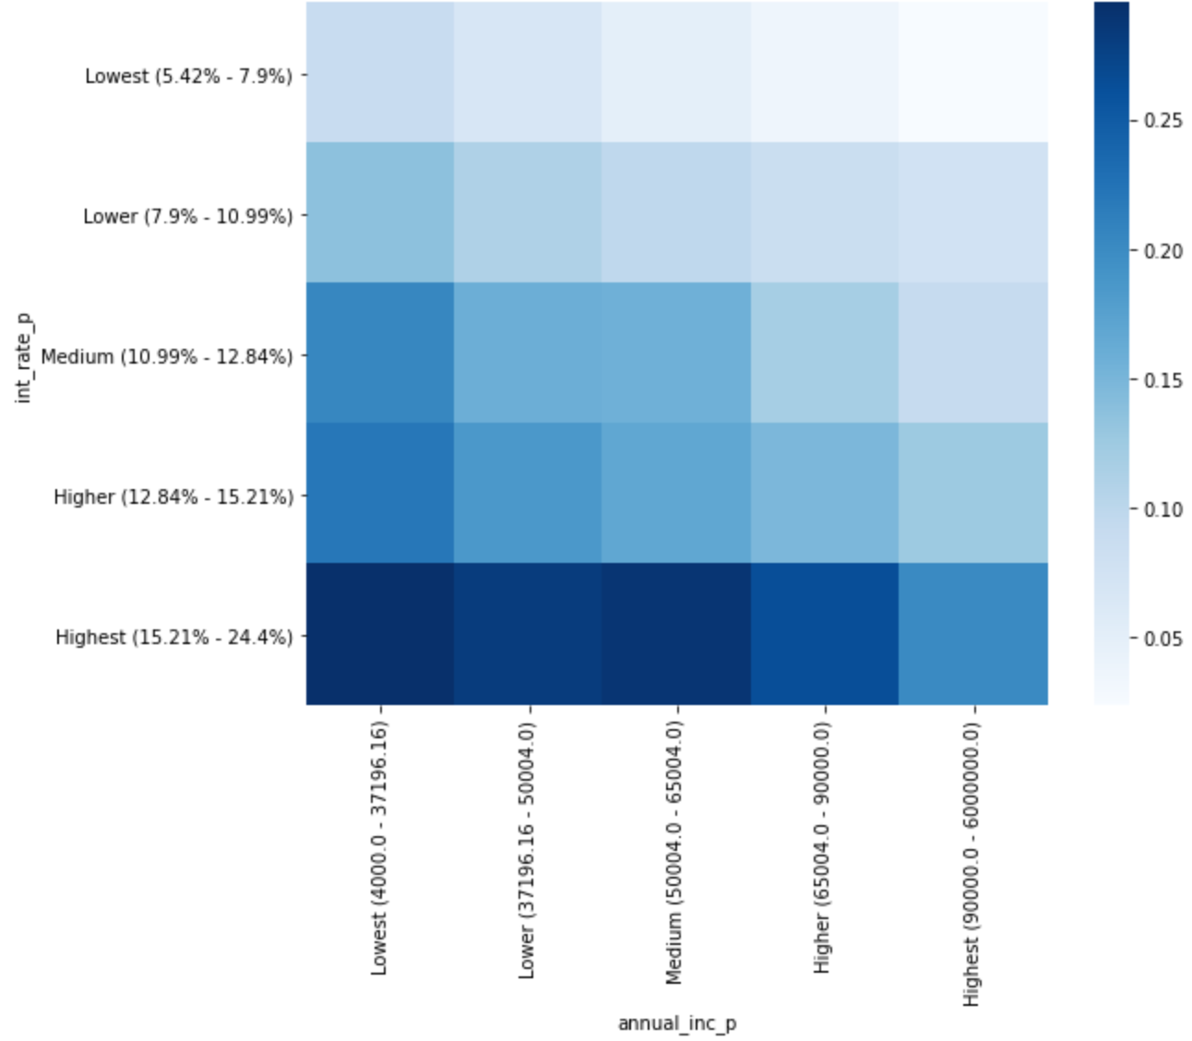
Finding 1: Annual Income with Loan Amount & Interest rates
High Loan Amounts (>16,000) given to low income borrowers (<37,196) are risky, should be avoided.
High Interest Rates (>15.21%) charged to low income borrowers (<37,196) are risky, should be avoided.
22

Slide 14
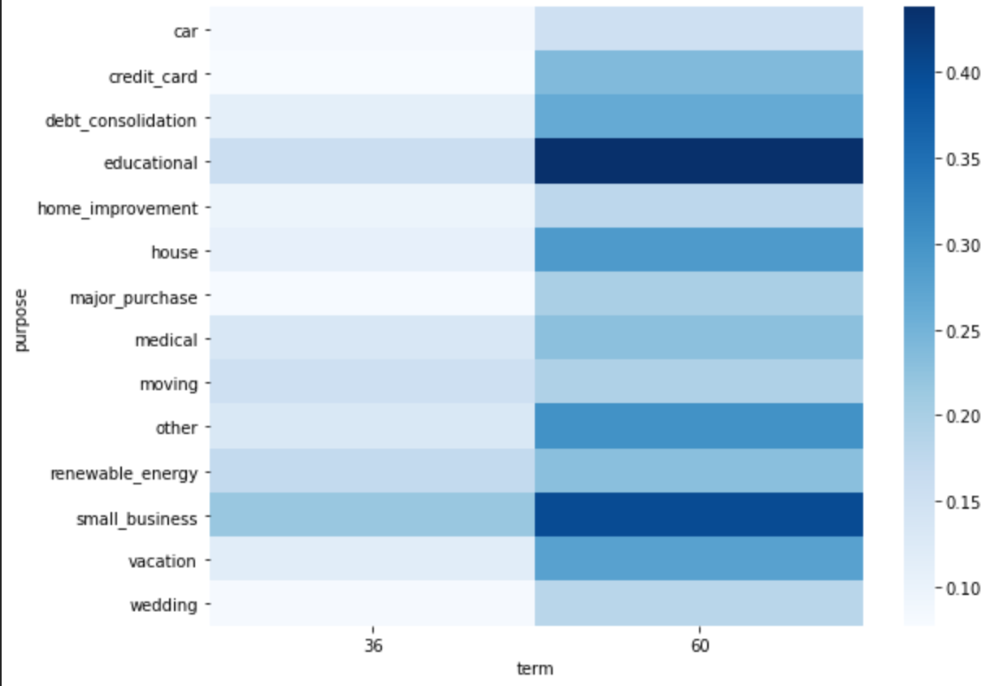
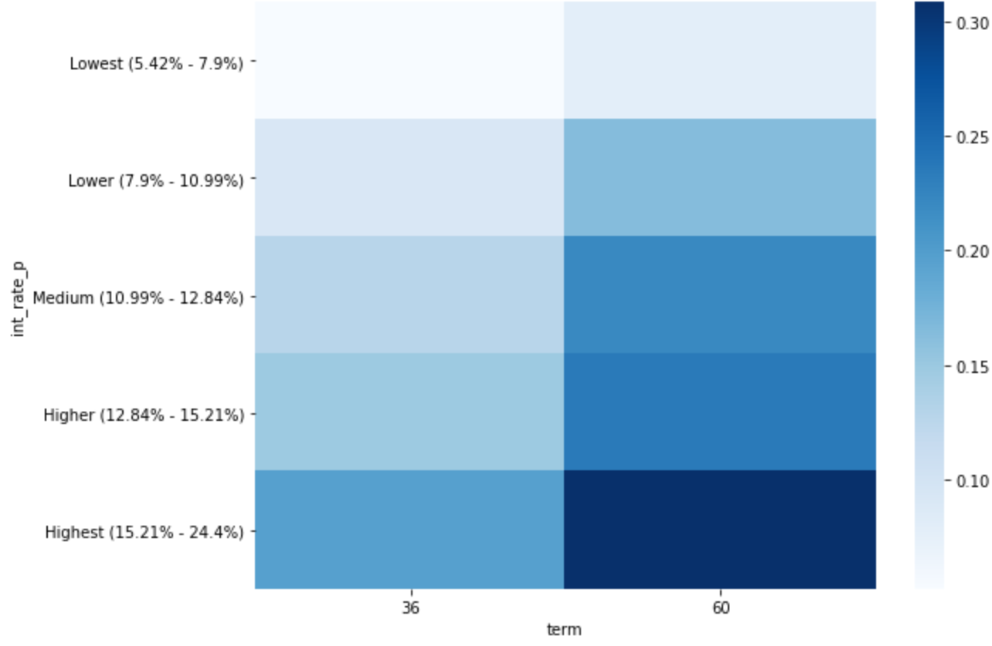
Finding 2: Term with Purpose & Interest Rate
Long Term(5 years) Educational loans are risky, should be avoided.
Long Term loans (5 Years) with high Interest Rate (>15.21%) is risky, should be avoided.
22

Slide 15
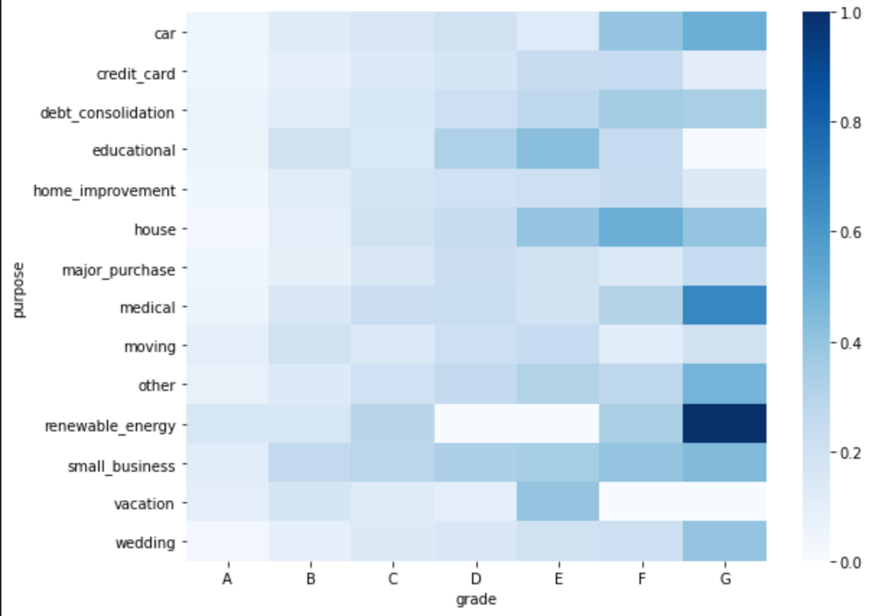
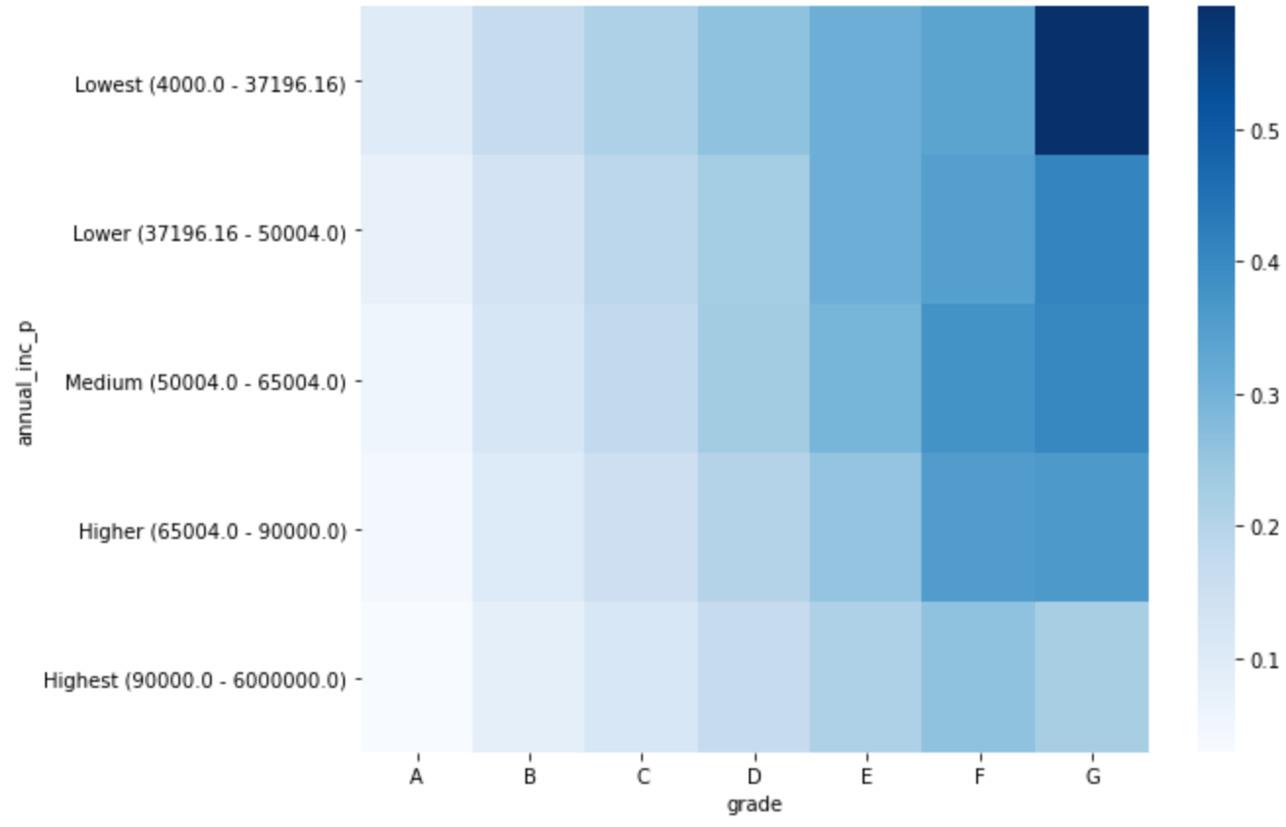
Finding 3: Grade with Purpose & Annual Income
Grade G loans given for Renewable Energy are risky, avoid it.
Grade G loans given to low income people is risky, avoid it.
22

Slide 16
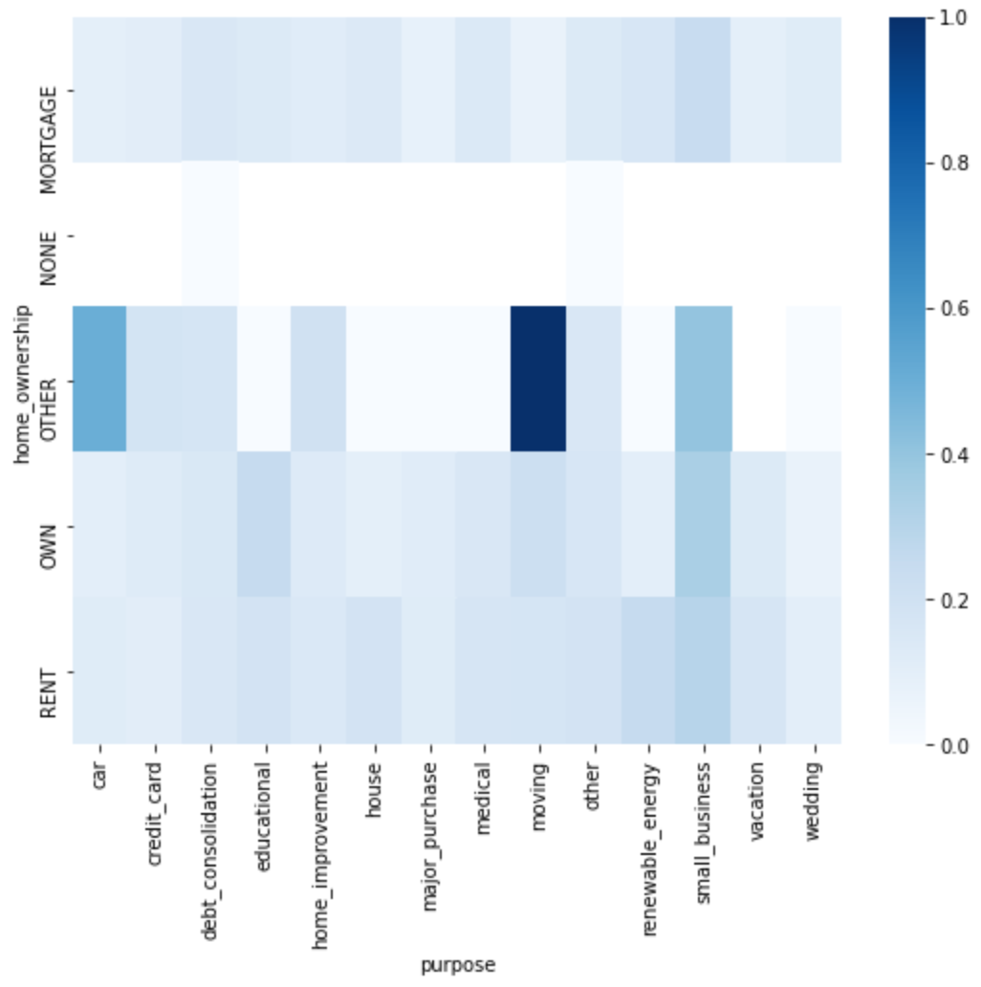
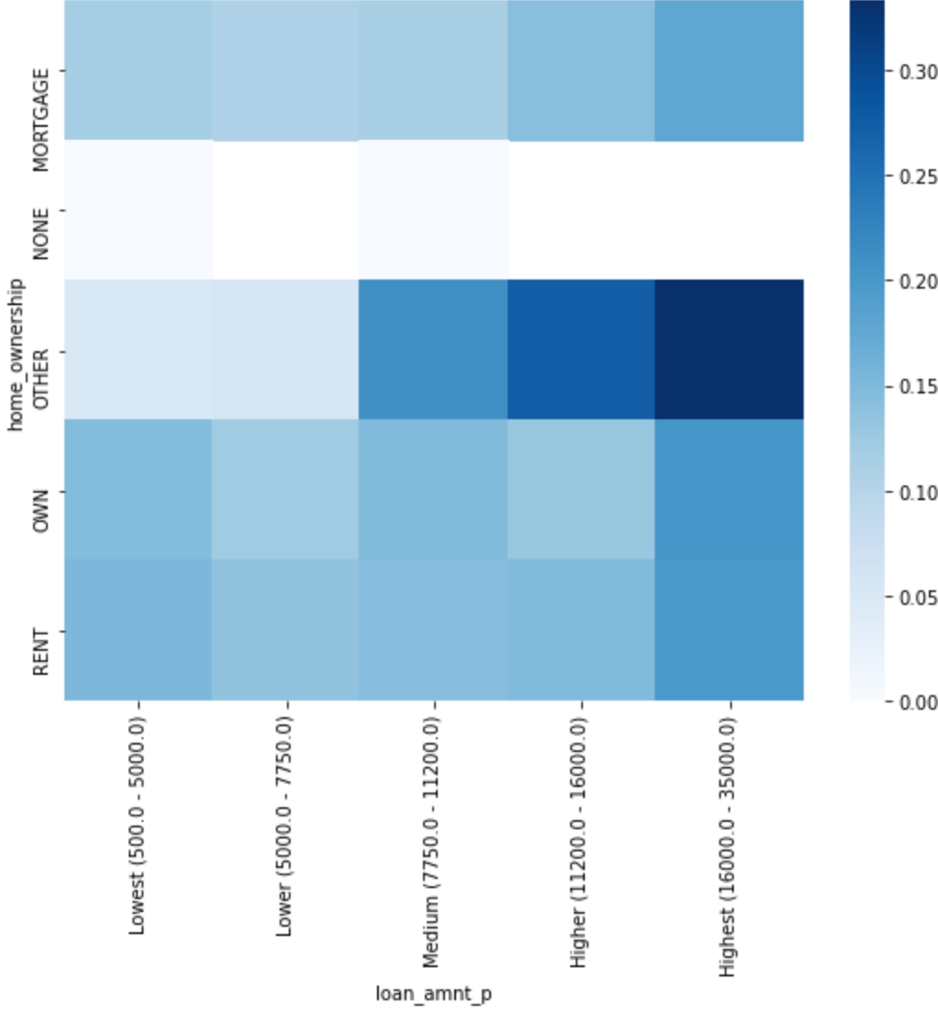
Finding 4: Home Ownership with Purpose & Loan Amounts
Folks who have home ownership classified as others default the most on loans taken for moving, avoid giving loans.
Same folks also default the most when they borrow loan amounts > 16,000. Avoid high loan amounts (>11,200)
22

Slide 17
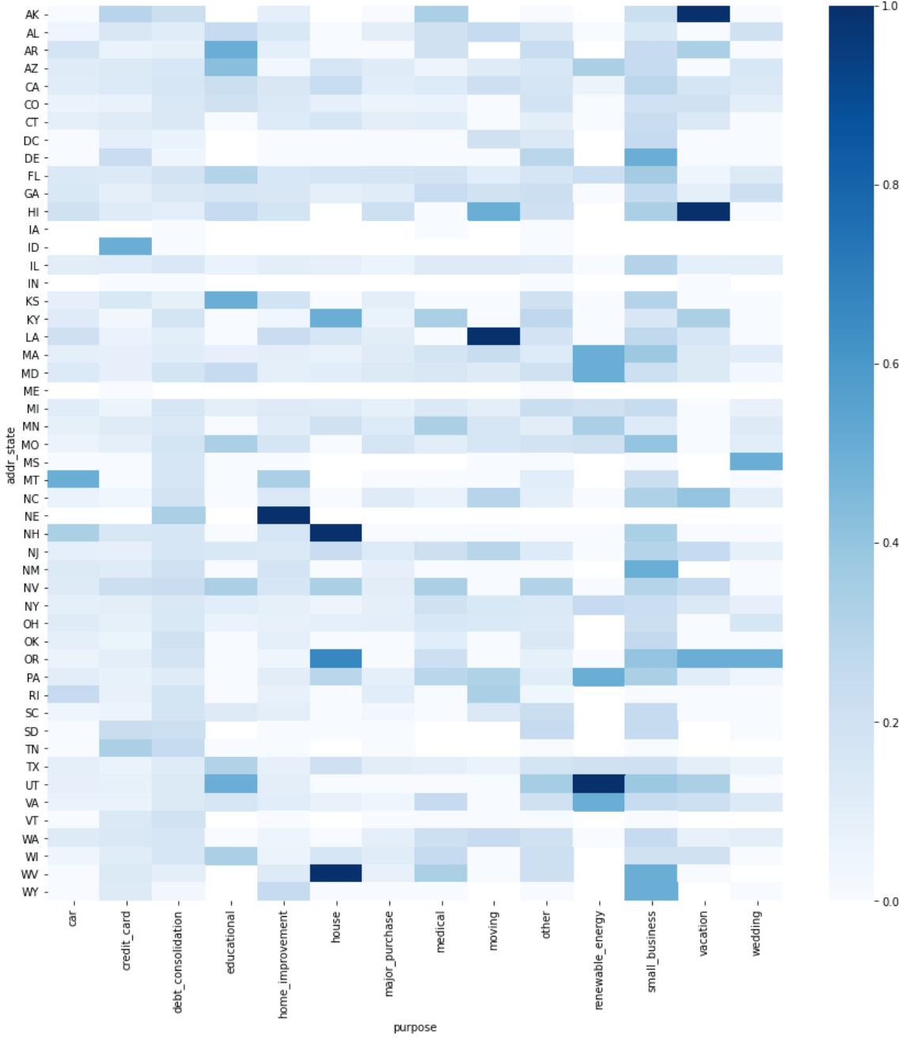
Finding 5: Address State and Purpose
Avoid giving loans to borrowers from -
Nebraska for Home improvement
New Hampshire and West Virginia for house
Los Angeles for moving
Utah for renewable energy
Hawaii and Alaska for vacation
22

Slide 18
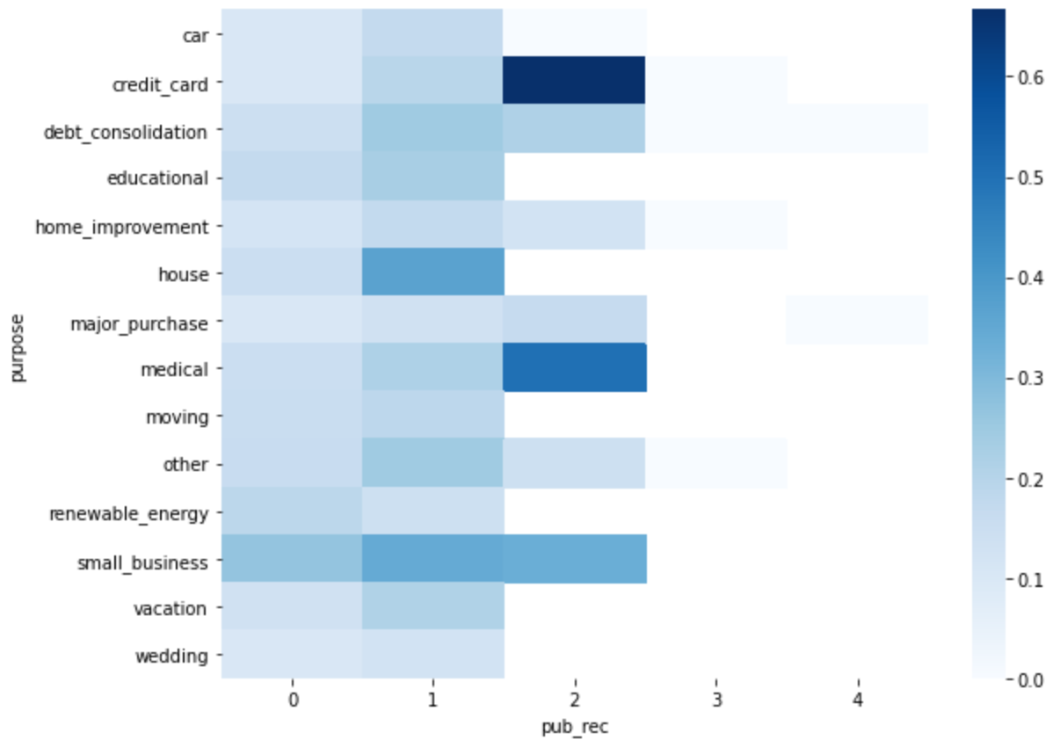
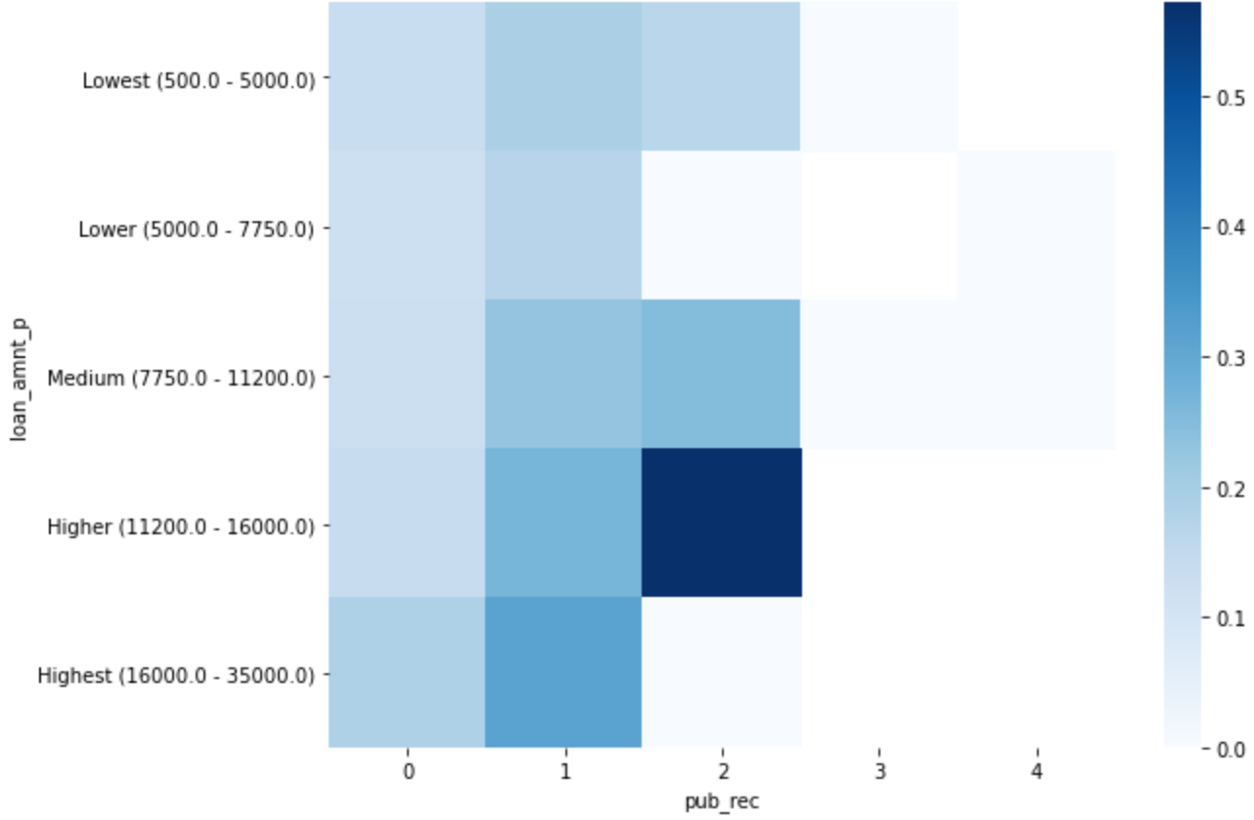
Finding 6: Derogatory Public Records with Purpose
Folks who have 2 public Derogatory Records and take loans for Credit Card are risky, avoid giving loans
Folks who have 2 public Derogatory Records and borrow high loan amounts (>11,200) are risky, avoid giving loans.
22

Slide 19


The Team
Shashank Bhardwaj
Promit Mazumdar

Slide 20
Thank You

